Slide 1

How The Opioid Crisis Is Putting A Strain On The Foster Care System
Patrick Hreha & Nick Weaver

Slide 2
Hypothesis
In Ohio, the opioid crisis has directly impacted the number of kids in foster care.

Slide 3
Questions to Answer
How has the opioid crisis impacted the foster care system in the state of Ohio?
Which counties had the biggest impact on the opioid crisis?
Which counties had the biggest impact on the number of kids in foster care?

Slide 4
Background
The drug data was pulled from the Ohio Department of Health website using their Ohio Public Health Data Warehouse.
Variables we used to pull the data:
Fentanyl, Heroin, Methadone, Opiates, Other Opioids and Prescription Opiates
Other variables we pulled from the ODH website:
The number of deaths from each drug per county between 2008 and 2017
The population of each county between 2008 and 2017.
The foster care data was pulled from the Kids Count website using their Kids Count Data Center and from the United States Children’s Bureau.

Slide 5
Data Exploration and Cleanup Process
Created reports from respective websites
Cleaned up the data
Merged files
Analyzed the data
Created graphs
Made observations

Slide 6
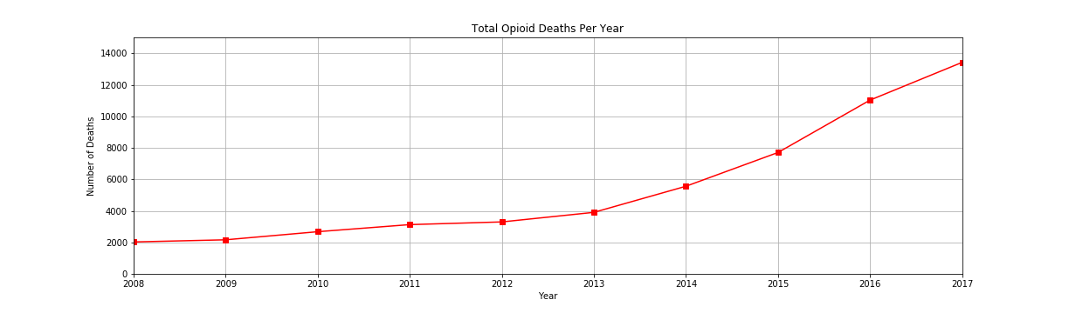
Analysis Process

Slide 7
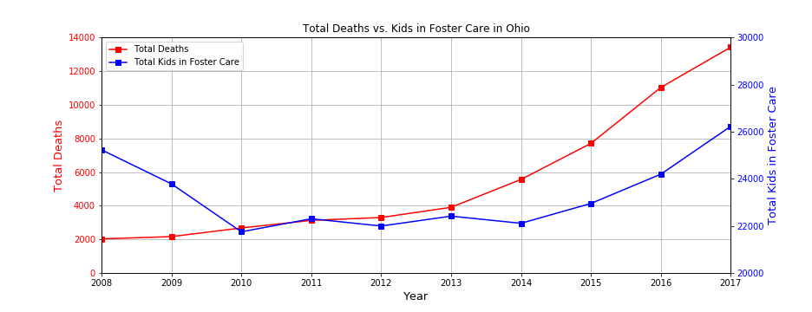
Analysis Process (cont.)

Slide 8
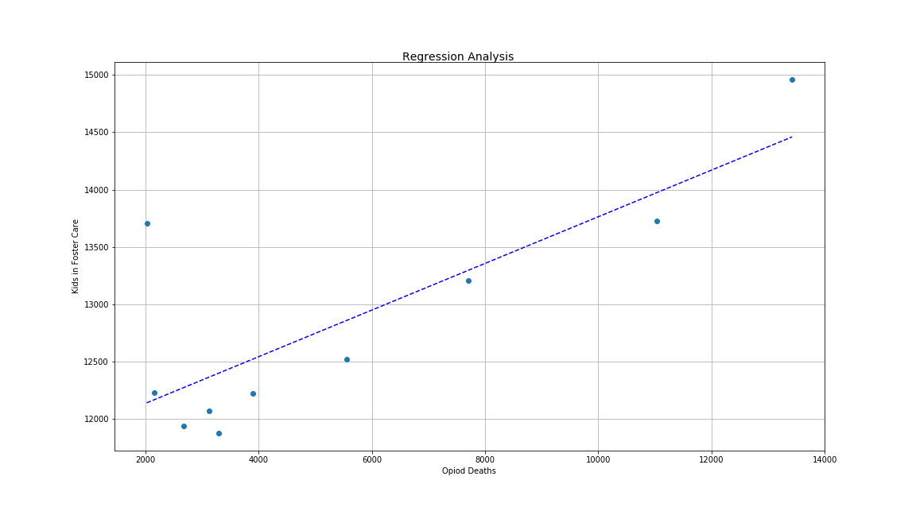
Analysis Process (cont.)
slope = 0.2035673889250735 intercept = 11727.468970240174 r = 0.7947168679757042 p = 0.006014443163470292 err = 0.05496995563769366

Slide 9
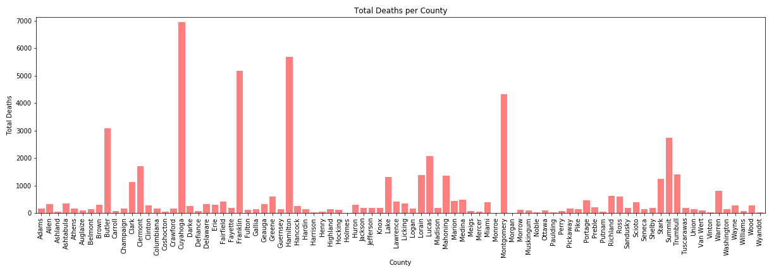
Analysis Process (cont.)

Slide 10
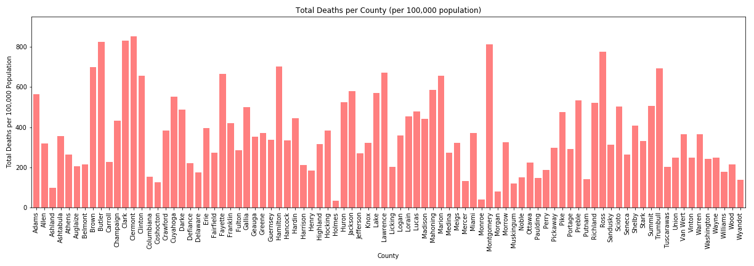
Analysis Process (cont.)

Slide 11
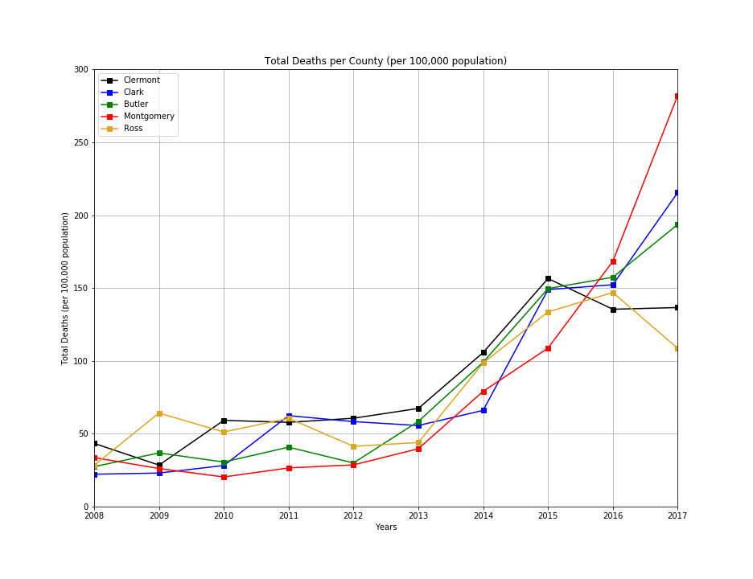
Analysis Process (cont.)

Slide 12
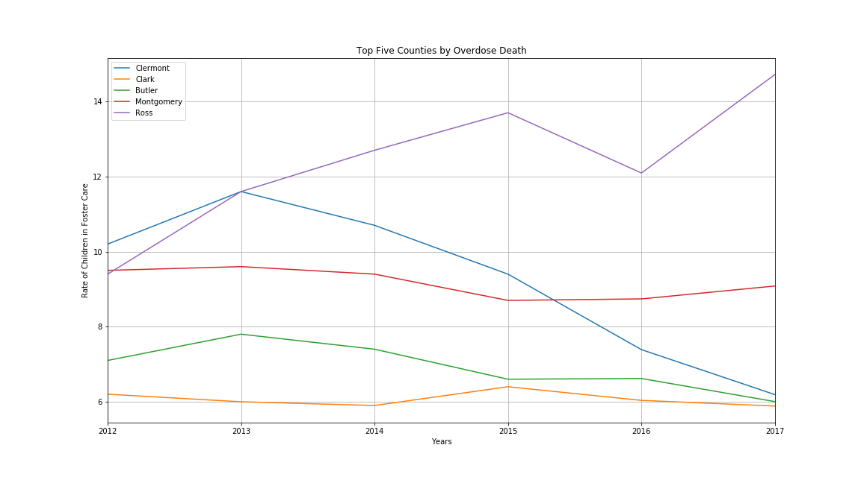
Analysis Process (cont.)

Slide 13
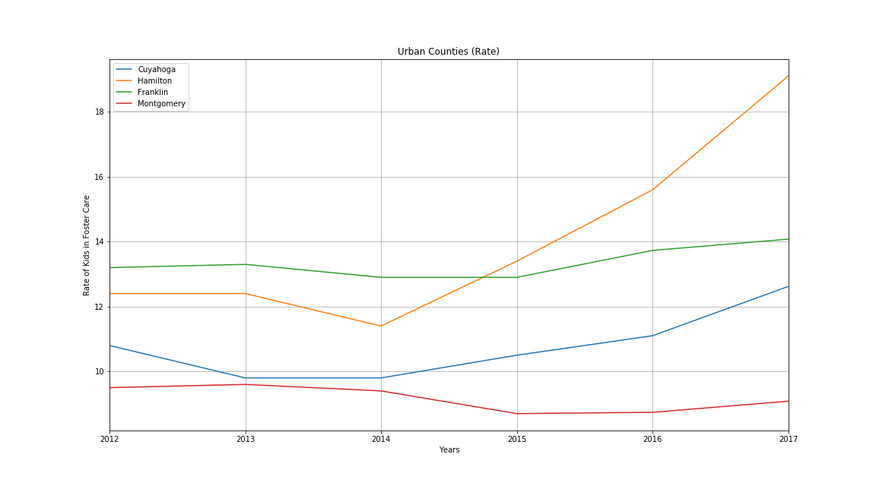
Analysis Process (cont.)

Slide 14
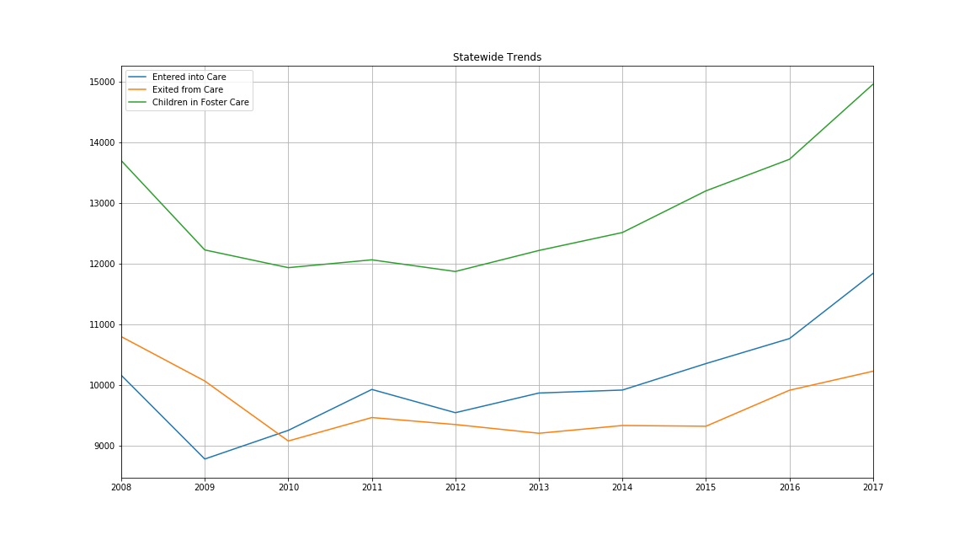
Process Analysis (cont.)

Slide 15
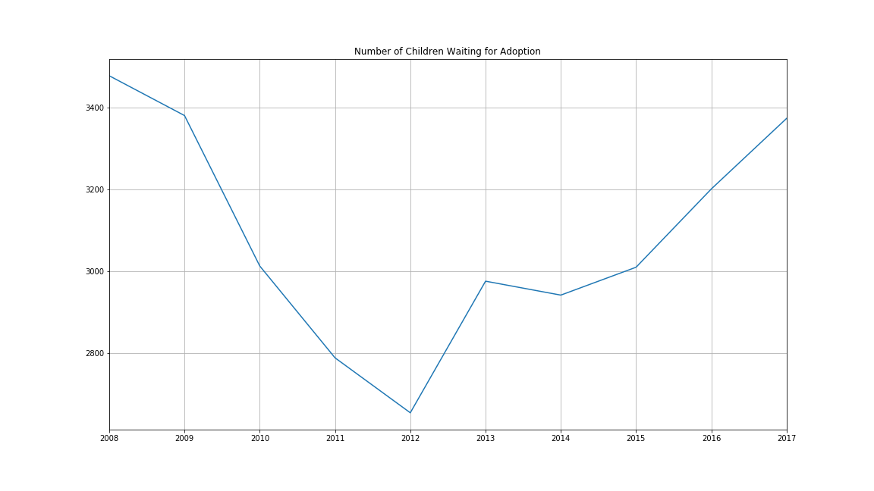
Analysis Process (cont.)

Slide 16
CONCLUSION

